Slide 1
Excretory system
Year 11 Biology
Bremer SHS

Slide 2
recap
Outline the role of the excretory system.
Name the parts of the excretory system and identify the substance/s that they remove.
Explain how nitrogenous wastes are formed.
Name the molecules that are filtered by the kidneys.
Explain why all glucose is reabsorbed during filtration.
Identify where the net movement of water will occur.

Slide 3
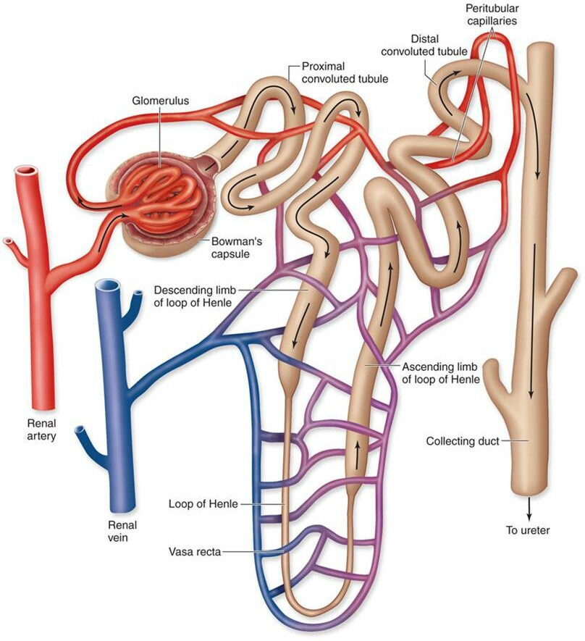
THE GREAT NEPHRON JOURNEY!
All wastes will make the following journey:
Renal artery
Glomerulus
Bowman’s Capsule
Proximal Convoluted Tubule
Loop of Henle
Distal Convoluted Tubule
Collecting Duct
Ureter
Bladder
All other materials are reabsorbed by capillaries and continue to the renal vein.

Slide 4
HYDROSTATIC PRESSURE
The process by which glomerular filtration occurs is called renal ultrafiltration.
The force of hydrostatic pressure in the glomerulus (the force exerted from the pressure of the blood vessel itself) is the driving force that pushes one fifth of blood plasma out through the capillary walls in to the Bowman’s capsule.
Blood plasma forced out of the glomerulus carries all molecules small enough to pass through with it. (eg - urea, glucose, amino acids, minerals, etc.)
All molecules in excess will not be reabsorbed by the nephron.

Slide 5
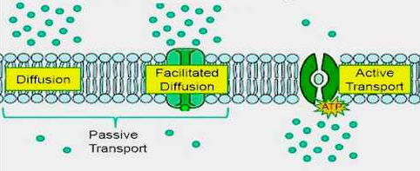
Movement of molecules
The mechanisms of reabsorption and secretion include:
Passive diffusion—passing through plasma membranes of the kidney epithelial cells by concentration gradients.
Active transport—membrane-bound pumps (such as NA⁺/K⁺ pumps) with carrier proteins that carry substances across the plasma membranes.
Cotransport—this process is particularly important for the reabsorption of water. Water can follow other molecules that are actively transported, particularly glucose and sodium ions in the nephron.

Slide 6
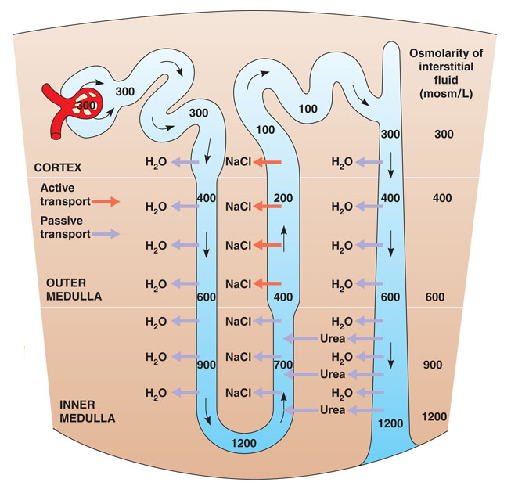
Check for understanding
Osmolarity is the measure of ion concentration. As filtrate passes through the nephron, its osmolarity changes as ions and water are reabsorbed.
Describe the trend in osmolarity of filtrate as it passes through the nephron.

Slide 7
reabsorption
The capillaries located alongside the nephron allow reabsorption and secretion between the blood and nephron.
Proximal Convoluted Tubule – water, glucose, amino acids and minerals are reabsorbed by active and passive transport.
Loop of Henle (descending) – water flows out of tubule and in to interstitial fluid (extracellular space) and capillaries because concentration of dissolved ions is higher in the interstitial fluid.
Loop of Henle (ascending) – mineral ions moved out of thick walled section of tubule and in to the interstitial fluid by active transport as overall mechanism for concentrating the urine.
Distal Convoluted Tubule – variable amount of ions and water are reabsorbed depending on hormonal stimulus. Hormonal stimulus increases/decreases permeability of tubule.

Slide 8
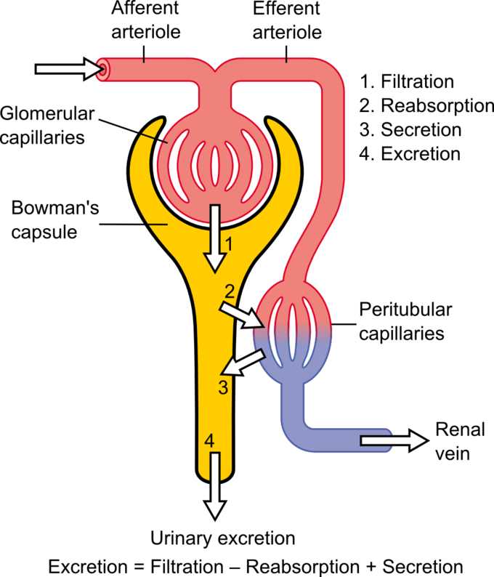
Renal secretion
The mechanisms by which secretion occurs are similar to those of reabsorption (passive diffusion, active transport and coupled transport), however these processes occur in the opposite direction.
During secretion some substances such as hydrogen ions, creatinine, and drugs will be removed from the blood through the peritubular capillary network into the collecting duct.

Slide 9
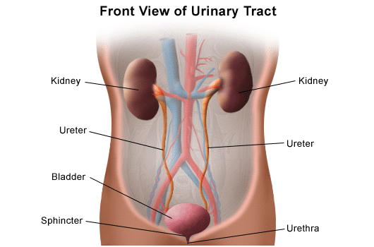
Production of urine
Urine that is formed via the three processes of filtration, reabsorption, and secretion leaves the kidney through the ureter, and is stored in the bladder before being removed through the urethra.
At this final stage it is only approximately one percent of the originally filtered volume, consisting mostly of water with highly diluted amounts of urea, creatinine, and variable concentrations of ions.

